Slide 1

Travel Safety
DSC 640, Final Presentation Gabrielle Beinars
Notes:
The purpose is to present key findings on traveling safety, specifically when comparing airflight to automobile.

Slide 2
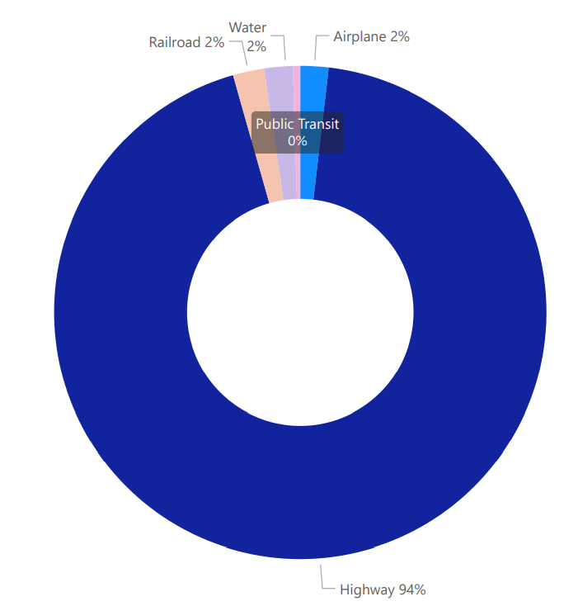
Fatal Accidents by Transportation Method

Slide 3
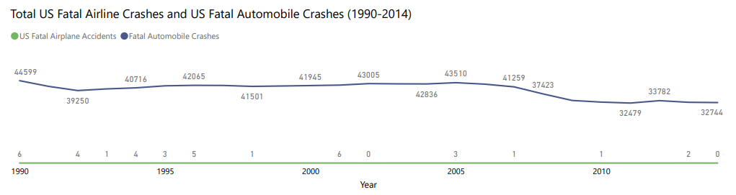
United States Accidents

Slide 4
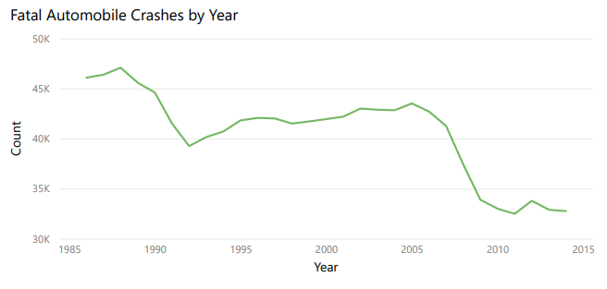
A Closer Look at Fatal Automobile Accidents

Slide 5
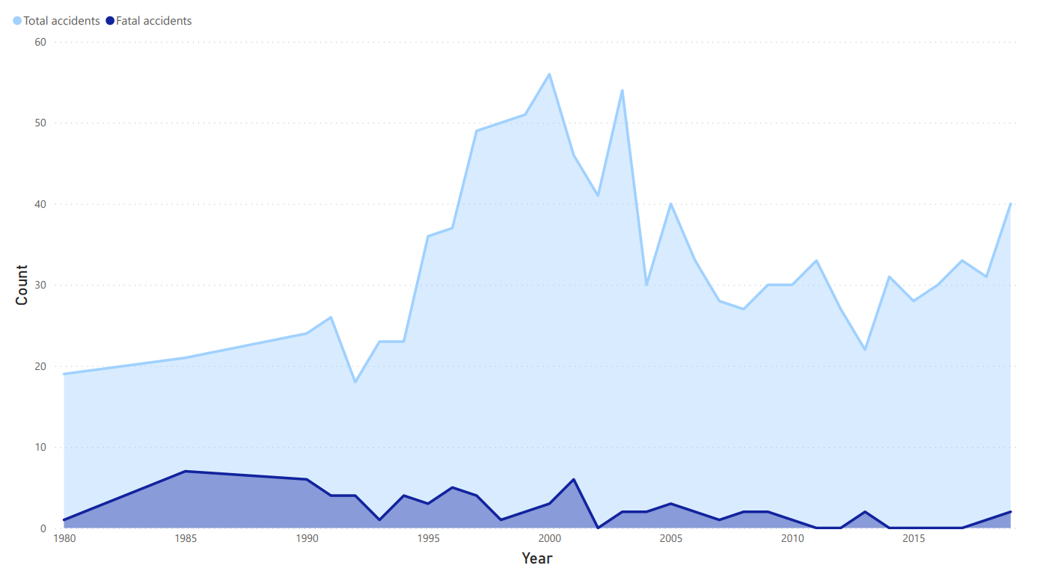
What Percentage of US Airplane Accidents are Fatal?

Slide 6
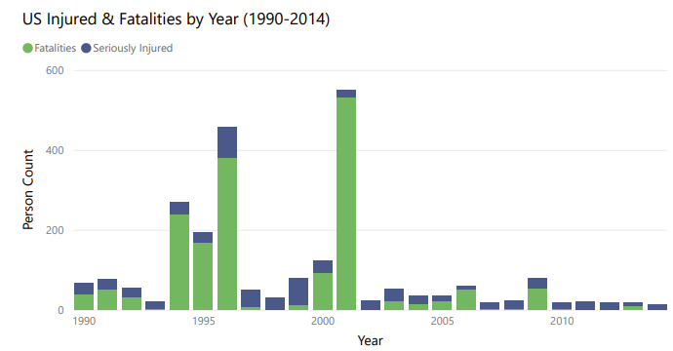

Slide 7
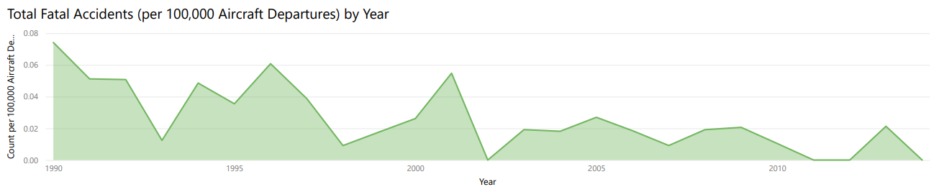
Fatal Airplane Accidents per 100,000 Aircraft Departures

Slide 8
Data
Website
https://gbeinars.wixsite.com/travelsafety, Travel Safety
US Air Carrier Safety Data, Bureau of Transportation Statistics
Airline Safety, Aviation Safety Network
Fatality Analysis Reporting System (FARS), NHTSA
https://github.com/gbeinars/DSC640

